Slide 1
Fabric defect detection
By :- Amit Puranik
Notes:
ID=d924773e-9a16-4d6d-9803-8cb819e99682 Recipe=text_billboard Type=TextOnly Variant=0 FamilyID=AccentBoxWalbaum_Zero

Slide 2
Index
Problem Statement
Flow Chart
Features
Experimentation and result
Conclusion

Slide 3
Problem Statement
Prepare a cost effective and accurate fabric defect detection system using machine learning.
3

Slide 4
Flow Chart
Data Collection
Image Pre-processing
Model Building
Evaluation & testing

Slide 5
Features
This project helps to detect faults in the fabric
Real time detection
Robustness in detection of defects

Slide 6
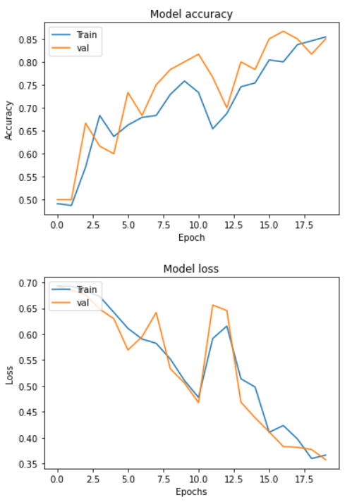
Experimentation and Result
CNN
Performance of model:
No. of Epochs | Batch size | Accuracy | Loss
10 | 10 | 70% | 44%
15 | 10 | 77% | 40%
20 | 10 | 85% | 35%

Slide 7
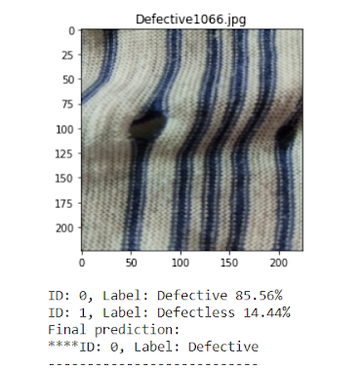
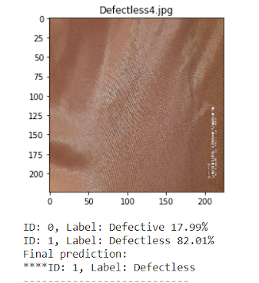
RESULTS
Fig.3. Predictions on defective image.
Fig. 4. Prediction on defectless image.

Slide 8
Conclusion
This fabric fault detection system is very effective to use in industries.
Using Machine learning, this project attains commendable results.
This project also satisfies its motive of cost – efficiency.
Thus, this project can be regarded as flagship.

Slide 9

Thank you

